Slide 1
JavaScript

Slide 2
what is JavaScript ?
JavaScript was initially created to “make web pages alive”.
The programs in this language are called scripts. They can be written right in a web page’s HTML and run automatically as the page loads.
Scripts are provided and executed as plain text. They don’t need special preparation or compilation to run.
In this aspect, JavaScript is very different from another language called java.

Slide 3
Why is it called JavaScript?
When JavaScript was created, it initially had another name: “LiveScript”. But Java was very popular at that time, so it was decided that positioning a new language as a “younger brother” of Java would help.
But as it evolved, JavaScript became a fully independent language with its own specification called ECMAScript, and now it has no relation to Java at all.

Slide 4
Why is it called JavaScript?
Today, JavaScript can execute not only in the browser, but also on the server, or actually on any device that has a special program called the JavaScript engine.
The browser has an embedded engine sometimes called a “JavaScript virtual machine”.
Different engines have different “codenames”. For example:
  V8 – in Chrome, Opera and Edge.
  SpiderMonkey – in Firefox.

Slide 5
How do engines work?
Engines are complicated. But the basics are easy.
  The engine (embedded if it’s a browser) reads (“parses”) the script.
  Then it converts (“compiles”) the script to machine code.
  And then the machine code runs, pretty fast.
The engine applies optimizations at each step of the process. It even watches the compiled script as it runs, analyzes the data that flows through it, and further optimizes the machine code based on that knowledge.

Slide 6
What can in-browser JavaScript do?
Modern JavaScript is a “safe” programming language. It does not provide low-level access to memory or the CPU, because it was initially created for browsers which do not require it.
JavaScript’s capabilities greatly depend on the environment it’s running in. For instance, Node.js supports functions that allow JavaScript to read/write arbitrary files, perform network requests, etc.
In-browser JavaScript can do everything related to webpage manipulation, interaction with the user, and the webserver.

Slide 7
What makes JavaScript unique?
There are at least three great things about JavaScript:
  Full integration with HTML/CSS.
  Simple things are done simply.
  Supported by all major browsers and enabled by default.
JavaScript is the only browser technology that combines these three things.
That’s what makes JavaScript unique. That’s why it’s the most widespread tool for creating browser interfaces.
That said, JavaScript can be used to create servers, mobile applications, etc.

Slide 8
Summary
  JavaScript was initially created as a browser-only language, but it is now used in many other environments as well.
  Today, JavaScript has a unique position as the most widely-adopted browser language, fully integrated with HTML/CSS.
  There are many languages that get “transpiled” to JavaScript and provide certain features. It is recommended to take a look at them, at least briefly, after mastering JavaScript.

Slide 9
Code editors
A code editor is the place where programmers spend most of their time.
There are two main types of code editors: IDEs and lightweight editors. Many people use one tool of each type.
1.visual studio code
2.notepad++

Slide 10
Developer console
Code is prone to errors. You will quite likely make errors… Oh, what am I talking about? You are absolutely going to make errors, at least if you’re a human, not a robot.
But in the browser, users don’t see errors by default. So, if something goes wrong in the script, we won’t see what’s broken and can’t fix it.
There’s an error in the JavaScript code on it. It’s hidden from a regular visitor’s eyes, so let’s open developer tools to see it.
In browsers:
Press F12 or, if you’re on Mac, then Cmd+Opt+J.
The developer tools will open on the Console tab by default.

Slide 11
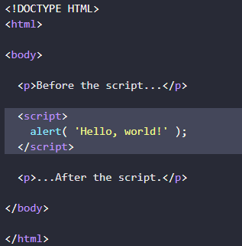
Fundamentals
we need a working environment to run our scripts
so, we will use script tag
JavaScript programs can be inserted almost anywhere into an HTML document using the <script> tag.

Slide 12
Modern markup
The <script> tag has a few attributes that are rarely used nowadays but can still be found in old code:
The type attribute: <script type=…>
The old HTML standard, HTML4, required a script to have a type. Usually it was type="text/javascript". It’s not required anymore. Also, the modern HTML standard totally changed the meaning of this attribute. Now, it can be used for JavaScript modules. But that’s an advanced topic, we’ll talk about modules in another part of the tutorial.

Slide 13

Modern markup
The language attribute: <script language=…>
This attribute was meant to show the language of the script. This attribute no longer makes sense because JavaScript is the default language. There is no need to use it. xxxx

Slide 14
External scripts
If we have a lot of JavaScript code, we can put it into a separate file.
Script files are attached to HTML with the src attribute:
<script src="/path/to/script.js"></script>
Here, /path/to/script.js is an absolute path to the script from the site root. One can also provide a relative path from the current page. For instance, src="script.js", just like src="./script.js", would mean a file "script.js" in the current folder.
We can give a full URL as well. For instance:
<script src="https://cdnjs.cloudflare.com/ajax/libs/lodash.js/4.17.11/lodash.js"></script>

Slide 15
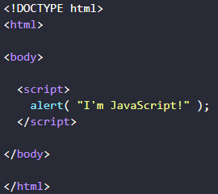
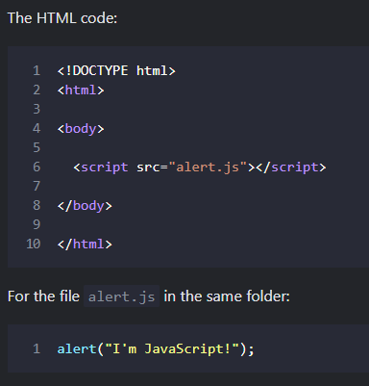
Task
Show an alert in sandbox in same page and in external page

Slide 16
The modern mode
"use strict"
For a long time, JavaScript evolved without compatibility issues. New features were added to the language while old functionality didn’t change.
That had the benefit of never breaking existing code. But the downside was that any mistake or an imperfect decision made by JavaScript’s creators got stuck in the language forever.
This was the case until 2009 when ECMAScript 5 (ES5) appeared. It added new features to the language and modified some of the existing ones. To keep the old code working, most such modifications are off by default. You need to explicitly enable them with a special directive: "use strict".

Slide 17

The modern mode
“use strict”
The directive looks like a string: "use strict" or 'use strict'. When it is located at the top of a script, the whole script works the “modern” way.
For example:
Ensure that “use strict” is at the top
Please make sure that "use strict" is at the top of your scripts, otherwise strict mode may not be enabled.

Slide 18

Comments
As time goes on, programs become more and more complex. It becomes necessary to add comments which describe what the code does and why.
Comments can be put into any place of a script. They don’t affect its execution because the engine simply ignores them.
One-line comments start with two forward slash characters //.

Slide 19
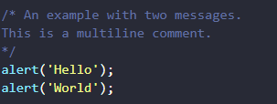
Comments
Multiline comments start with a forward slash and an asterisk /* and end with an asterisk and a forward slash */.
Like this:

Slide 20
Variables
Most of the time, a JavaScript application needs to work with information. Here are two examples:
  An online shop – the information might include goods being sold and a shopping cart.
  A chat application – the information might include users, messages, and much more.
Variables are used to store this information.
A variable is a “named storage” for data. We can use variables to store goodies, visitors, and other data.

Slide 21
Variables
To create a variable in JavaScript, use the let keyword.(first one)
Example:
let message;
message = 'Hello!';
alert(message);
we can combine the variable declaration and assignment into a single line:
let message = 'Hello!';
alert(message);
We can also declare multiple variables in one line:
let user = 'John', age = 25, message = 'Hello';

Slide 22
Variables
var instead of let(second one)
In older scripts, you may also find another keyword: var instead of let:
var message = 'Hello';
The var keyword is almost the same as let. It also declares a variable but in a slightly different, “old-school” way.

Slide 23
Variables Naming
There are two limitations on variable names in JavaScript:
  The name must contain only letters, digits, or the symbols $ and _.
  The first character must not be a digit.
Examples of valid names:
let userName;
let test123;

Slide 24
Variables Naming
There is a list of reserved words, which cannot be used as variable names because they are used by the language itself.
For example: let, class, return, and function are reserved.
The code below gives a syntax error:
let let = 5;
let return = 5;

Slide 25
Constants
To declare a constant (unchanging) variable(third), use const instead of let:
const myBirthday = '18.04.1982';
Variables declared using const are called “constants”. They cannot be reassigned.
An attempt to do so would cause an error:
const myBirthday = '18.04.1982';
myBirthday = '01.01.2001'; // error, can't reassign the constant!

Slide 26
Interaction Function
Interaction: alert, prompt, confirm
As we’ll be using the browser as our demo environment, let’s see a couple of functions to interact with the user: alert, prompt and confirm.
alert
This one we’ve seen already. It shows a message and waits for the user to press “OK”.
For example:
alert("Hello");

Slide 27
Interaction Function
prompt
The function prompt accepts two arguments:
result = prompt(title, [default]);
It shows a modal window with a text message, an input field for the visitor, and the buttons OK/Cancel.
title
The text to show the visitor.
default
An optional second parameter, the initial value for the input field.

Slide 28
Interaction Function
prompt
The call to prompt returns the text from the input field or null if the input was canceled.
let age = prompt('How old are you?', 100);
alert(`You are ${age} years old!`); // You are 100 years old!

Slide 29
Interaction Function
confirm
The syntax:
result = confirm(question);
The function confirm shows a modal window with a question and two buttons: OK and Cancel.
The result is true if OK is pressed and false otherwise.
For example:
let isBoss = confirm("Are you the boss?");
alert( isBoss ); // true if OK is pressed

Slide 30
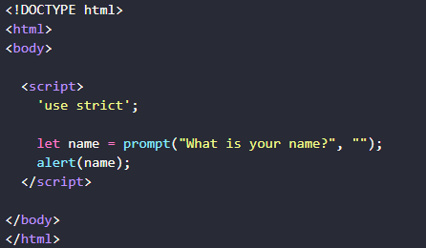
Task
Create a web-page that asks for a name and outputs it.

Slide 31
Data types
A value in JavaScript is always of a certain type. For example, a string or a number.
We can put any type in a variable. For example, a variable can at one moment be a string and then store a number:
// no error
let message = "hello";
message = 123456;
Programming languages that allow such things, such as JavaScript, are called “dynamically typed”, meaning that there exist data types, but variables are not bound to any of them.

Slide 32
Data types
Number
let n = 123;
n = 12.345;
The number type represents both integer and floating point numbers.
There are many operations for numbers, e.g. multiplication *, division /, addition +, subtraction -, and so on.
Besides regular numbers, there are so-called “special numeric values” which also belong to this data type: Infinity, -Infinity and NaN.

Slide 33
Data types
Number
Infinity represents the mathematical Infinity ∞. It is a special value that’s greater than any number.
We can get it as a result of division by zero:
alert( 1 / 0 ); // Infinity
NaN represents a computational error. It is a result of an incorrect or an undefined mathematical operation, for instance:
alert( "not a number" / 2 ); // NaN, such division is erroneous

Slide 34
Data types
Number
Rounding
One of the most used operations when working with numbers is rounding.
There are several built-in functions for rounding:
Math.floor:Rounds down: 3.1 becomes 3, and -1.1 becomes -2.
Math.ceil:Rounds up: 3.1 becomes 4, and -1.1 becomes -1.
Math.round:Rounds to the nearest integer: 3.1 becomes 3, 3.6 becomes 4. In the middle cases 3.5 rounds up to 4, and -3.5 rounds up to -3.
Example:
let num = 1.23456;
alert( Math.round(num * 100) / 100 );
// 1.23456 -> 123.456 -> 123 -> 1.23

Slide 35
Data types
Number
parseInt and parseFloat
The sole exception is spaces at the beginning or at the end of the string, as they are ignored.
But in real life, we often have values in units, like "100px" or "12pt" in CSS. Also in many countries, the currency symbol goes after the amount, so we have "19€" and would like to extract a numeric value out of that.
That’s what parseInt and parseFloat are for.

Slide 36
Data types
Number
parseInt and parseFloat
They “read” a number from a string until they can’t. In case of an error, the gathered number is returned. The function parseInt returns an integer, whilst parseFloat will return a floating-point number:
alert( parseInt('100px') ); // 100
alert( parseFloat('12.5em') ); // 12.5
alert( parseInt('12.3') ); // 12, only the integer part is returned
alert( parseFloat('12.3.4') ); // 12.3, the second point stops the reading

Slide 37
Data types
String
Backticks are “extended functionality” quotes. They allow us to embed variables and expressions into a string by wrapping them in ${…}, for example:
let name = "John";// embed a variable
alert( `Hello, ${name}!` ); // Hello, John!// embed an expression
alert( `the result is ${1 + 2}` ); // the result is 3
The expression inside ${…} is evaluated and the result becomes a part of the string. We can put anything in there: a variable like name or an arithmetical expression like 1 + 2 or something more complex.
Please note that this can only be done in backticks. Other quotes don’t have this embedding functionality!

Slide 38
Data types
String
To get a character at position pos, use square brackets [pos] or call the method str.at(pos). The first character starts from the zero position
let str = `Hello`;// the first character
alert( str[0] ); // H
alert( str.at(0) ); // H // the first character
alert( str[str.length - 1] ); // o
alert( str.at(-1) ); //?????????????

Slide 39
Data types
String
The first method is str.indexOf(substr, pos).
It looks for the substr in str, starting from the given position pos, and returns the position where the match was found or -1 if nothing can be found.
For instance:
let str = 'Widget with id';
alert( str.indexOf('Widget') ); // 0, because 'Widget' is found at the beginning
alert( str.indexOf('widget') ); // -1, not found, the search is case-sensitive

Slide 40
Data types
String
includes, startsWith, endsWith
The more modern method str.includes(substr, pos) returns true/false depending on whether str contains substr within.
It’s the right choice if we need to test for the match, but don’t need its position:
alert( "Widget with id".includes("Widget") ); // true
alert( "Hello".includes("Bye") ); // false
alert( "Widget".startsWith("Wid") ); // true, "Widget" starts with "Wid"
alert( "Widget".endsWith("get") ); // true, "Widget" ends with "get"

Slide 41
Data types
String
Getting a substring
There is method in JavaScript to get a substring: slice.
str.slice(start [, end])
Returns the part of the string from start to (but not including) end.
For instance:
let str = "stringify";
alert( str.slice(0, 5) ); // 'strin', the substring from 0 to 5 (not including 5)
alert( str.slice(0, 1) ); // 's', from 0 to 1, but not including 1, so only character at 0

Slide 42
Data types
Arrays
Objects allow you to store keyed collections of values. That’s fine.
But quite often we find that we need an ordered collection, where we have a 1st, a 2nd, a 3rd element and so on. For example, we need that to store a list of something: users, goods, HTML elements etc.
It is not convenient to use an object here, because it provides no methods to manage the order of elements. We can’t insert a new property “between” the existing ones. Objects are just not meant for such use.
There exists a special data structure named Array, to store ordered collections.
Declaration

Slide 43
Data types
Arrays
There are two syntaxes for creating an empty array:
let arr = new Array();
let arr = [];
the second syntax is used. We can supply initial elements in the brackets:
let fruits = ["Apple", "Orange", "Plum"];
Array elements are numbered, starting with zero.We can get an element by its number in square brackets:
let fruits = ["Apple", "Orange", "Plum"];
alert( fruits[0] ); // Apple
alert( fruits[1] ); // Orange alert( fruits[2] ); // Plum

Slide 44
Data types
Arrays
…Or add a new one to the array:
fruits[3] = 'Lemon'; // now ["Apple", "Orange", "Pear", "Lemon"]
The total count of the elements in the array is its length:
let fruits = ["Apple", "Orange", "Plum"];
alert( fruits.length ); // 3
We can also use alert to show the whole array.
let fruits = ["Apple", "Orange", "Plum"];
alert( fruits ); // Apple,Orange,Plum

Slide 45
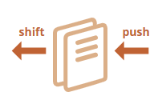
Data types
Arrays
Methods pop/push,
A queue is one of the most common uses of an array. In computer science, this means an ordered collection of elements which supports two operations:
  push appends an element to the end.

Slide 46
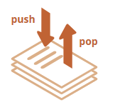
Data types
Arrays
Methods pop/push,
Arrays support both operations.
In practice we need it very often. For example, a queue of messages that need to be shown on-screen.
There’s another use case for arrays – the data structure named stack.
It supports two operations:
  push adds an element to the end.
  pop takes an element from the end.
A stack is usually illustrated as a pack of cards: new cards are added to the top or taken from the top:

Slide 47
Data types
Arrays
Methods that work with the end of the array:
pop
Extracts the last element of the array and returns it:
let fruits = ["Apple", "Orange", "Pear"];
alert( fruits.pop() ); // remove "Pear" and alert it
alert( fruits ); // Apple, Orange
Both fruits.pop() and fruits.at(-1) return the last element of the array, but fruits.pop() also modifies the array by removing it.

Slide 48
Data types
Arrays
Loops
One of the oldest ways to cycle array items is the for loop over indexes:
let arr = ["Apple", "Orange", "Pear"];
for (let i = 0; i < arr.length; i++)
{alert( arr[i] );}
But for arrays there is another form of loop, for..of:
let fruits = ["Apple", "Orange", "Plum"];// iterates over array elements
for (let fruit of fruits)
{alert( fruit );}

Slide 49
Data types
Arrays
toString
Arrays have their own implementation of toString method that returns a comma-separated list of elements.
For instance:
let arr = [1, 2, 3];
alert(String(arr) ); // 1,2,3
alert( String(arr) === '1,2,3' ); // true

Slide 50
Data types
Arrays
map
The arr.map method is one of the most useful and often used.
It calls the function for each element of the array and returns the array of results.
For instance, here we transform each element into its length:
let lengths = ["Bilbo", "Gandalf", "Nazgul"].map(item => item.length);
alert(lengths); // 5,7,6
sort(fn)
The call to arr.sort() sorts the array in place, changing its element order.
let arr = [ 1, 15 ,2];// the method reorders the content of arr
arr.sort(); alert( arr ); // 1, 2,15

Slide 51
Data types
Arrays
split and join
Here’s the situation from real life. We are writing a messaging app, and the person enters the comma-delimited list of receivers: John, Pete, Mary. But for us an array of names would be much more comfortable than a single string. How to get it?
The str.split(delim) method does exactly that. It splits the string into an array by the given delimiter delim.In the example below, we split by a comma:
let names = 'Bilbo, Gandalf, Nazgul';
let arr = names.split(', ');
for (let name of arr)
{alert( `A message to ${name}.` ); // A message to Bilbo (and other names)}

Slide 52
Data types
Arrays
split and join
The call arr.join(glue) does the reverse to split. It creates a string of arr items joined by glue between them.
For instance:
let arr = ['Bilbo', 'Gandalf', 'Nazgul'];
let str = arr.join(';'); // glue the array into a string using ;
alert( str ); // Bilbo;Gandalf;Nazgul

Slide 53
Data types
Boolean (logical type)
The boolean type has only two values: true and false.
This type is commonly used to store yes/no values: true means “yes, correct”, and false means “no, incorrect”.
For instance:
let nameFieldChecked = true; // yes, name field is checked
let ageFieldChecked = false; // no, age field is not checked

Slide 54
Data types
The “null” value
The special null value does not belong to any of the types described above.
It forms a separate type of its own which contains only the null value:
let age = null;
In JavaScript, null is not a “reference to a non-existing object” or a “null pointer” like in some other languages.
It’s just a special value which represents “nothing”, “empty” or “value unknown”.
The code above states that age is unknown.

Slide 55
Data types
The “undefined” value
The special value undefined also stands apart. It makes a type of its own, just like null.
The meaning of undefined is “value is not assigned”.
If a variable is declared, but not assigned, then its value is undefined:
let age;
alert(age); // shows "undefined"

Slide 56
Data types
Objects
As we know from the chapter Data types, there are eight data types in JavaScript. Seven of them are called “primitive”, because their values contain only a single thing (be it a string or a number or whatever).
In contrast, objects are used to store keyed collections of various data and more complex entities. In JavaScript, objects penetrate almost every aspect of the language. So we must understand them first before going in-depth anywhere else.

Slide 57
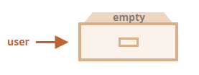
Data types
Objects
We can imagine an object as a cabinet with signed files. Every piece of data is stored in its file by the key. It’s easy to find a file by its name or add/remove a file.
An empty object (“empty cabinet”) can be created using one of two syntaxes:
let user = new Object(); // "object constructor" syntax
let user = {}; // "object literal" syntax

Slide 58
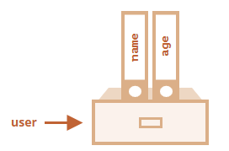
Data types
Objects
Literals and properties
We can immediately put some properties into {...} as “key: value” pairs:
let user = { // an object
name: "John", // by key "name" store value "John"
age: 30 // by key "age" store value 30};
A property has a key (also known as “name” or “identifier”) before the colon ":" and a value to the right of it.
In the user object, there are two properties:
  The first property has the name "name" and the value "John".
  The second one has the name "age" and the value 30.

Slide 59
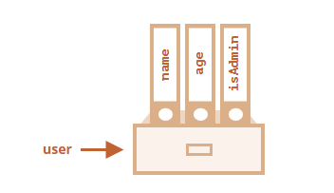
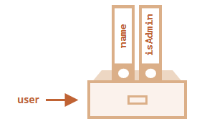
Data types
Objects
Literals and properties
We can add, remove and read files from it at any time.
Property values are accessible using the dot notation:
// get property values of the object:
alert( user.name ); // John
alert( user.age ); // 30
The value can be of any type. Let’s add a boolean one:
user.isAdmin = true;
To remove a property, we can use the delete operator:
delete user.age;

Slide 60
Task
Objects
Write the code, one line for each action:
  Create an empty object student.
  Add the property name with the value John.
  Add the property grade with the value 2.
  Change the value of the grade to 4.
  Remove the property grade from the object.

Slide 61
Task
Objects
Create a function multiplyNumeric(obj) that multiplies all numeric property values of obj by 2.
For instance:
// before the call
let menu = {width: 200,height: 300,title: "My menu"};
multiplyNumeric(menu);
// after the call
menu = {width: 400,height: 600,title: "My menu"};

Slide 62
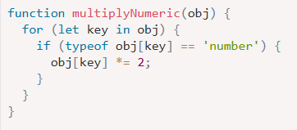
Task
Objects
Create a function multiplyNumeric(obj) that multiplies all numeric property values of obj by 2.

Slide 63
Data types
Objects
If you’ve just started to read the tutorial and learn JavaScript, maybe the problem hasn’t touched you yet, but it’s quite common.
As an example, let’s say we have user objects that hold the information about our users.
Most of our users have addresses in user.address property, with the street user.address.street, but some did not provide them.
In such case, when we attempt to get user.address.street, and the user happens to be without an address, we get an error:
let user = {}; // a user without "address" property
alert(user.address.street); // Error!

Slide 64
Data types
Objects
The optional chaining ?. stops the evaluation if the value before ?. is undefined or null and returns undefined.
Further in this article, for brevity, we’ll be saying that something “exists” if it’s not null and not undefined.
In other words, value?.prop:
  works as value.prop, if value exists,
  otherwise (when value is undefined/null) it returns undefined.
Here’s the safe way to access user.address.street using ?.:
let user = {}; // user has no address
alert( user?.address?.street ); // undefined (no error)

Slide 65
Task
What is the output of the script?
let name = "Ilya";
alert( `hello ${1}` ); // ?
alert( `hello ${"name"}` ); // ?
alert( `hello ${name}` ); // ?

Slide 66
Date and time
Let’s meet a new built-in object: Date. It stores the date, time and provides methods for date/time management.
For instance, we can use it to store creation/modification times, to measure time, or just to print out the current date.
Creation
To create a new Date object call new Date() with one of the following arguments:
new Date()
Without arguments – create a Date object for the current date and time:
let now = new Date();
alert( now ); // shows current date/time

Slide 67
Date and time
Access date components
There are methods to access the year, month and so on from the Date object:
getFullYear()
Get the year (4 digits)
getMonth()
Get the month, from 0 to 11.
getDate()
Get the day of month, from 1 to 31, the name of the method does look a little bit strange.
getHours(), getMinutes(), getSeconds(), getMilliseconds()
Get the corresponding time components.

Slide 68
Date and time
Examples:
// current date
let date = new Date();// the hour in your current time zone
alert( date.getHours() );
let today = new Date();
today.setHours(0);
alert(today); // still today, but the hour is changed to 0
today.setHours(0, 0, 0, 0);
alert(today); // still today, now 00:00:00 sharp.

Slide 69
JSON
The JSON (JavaScript Object Notation) is a general format to represent values and objects.Initially it was made for JavaScript, but many other languages have libraries to handle it as well. So it’s easy to use JSON for data exchange when the client uses JavaScript and the server is written on Ruby/PHP/Java/Whatever.
JavaScript provides methods:
  JSON.stringify to convert objects into JSON.
  JSON.parse to convert JSON back into an object.

Slide 70
JSON
For instance, here we JSON.stringify a student:
let student = {name: 'John',age: 30,isAdmin: false,courses: ['html', 'css', 'js'],spouse: null};
let json = JSON.stringify(student);
alert(typeof json); // we've got a string!
alert(json); /* JSON-encoded object:
‘{
"name": "John","age": 30,"isAdmin": false,
"courses": ["html", "css", "js"],"spouse": null
}’
*/

Slide 71
JSON
JSON.parse
To decode a JSON-string, we need another method named JSON.parse.
The syntax:
let value = JSON.parse(str[, reviver]);
str:JSON-string to parse.
reviver:Optional function(key,value) that will be called for each (key, value) pair and can transform the value.
// stringified array
let numbers = "[0, 1, 2, 3]";
numbers = JSON.parse(numbers);
alert( numbers[1] ); // 1

Slide 72
JSON
JSON.parse
examples:
let userData = '{ "name": "John", "age": 35, "isAdmin": false, "friends": [0,1,2,3] }';
let user = JSON.parse(userData);
alert( user.friends[1] ); // 1

Slide 73
Operators
Mathematical Operators:
The following math operations are supported:
  Addition +,
  Subtraction -,
  Multiplication *,
  Division /,
  Remainder %,
  Exponentiation **.
The first four are straightforward, while % and ** need a few words about them.

Slide 74
Operators
Mathematical Operators:
Remainder %
The remainder operator %, despite its appearance, is not related to percents.
The result of a % b is the remainder of the integer division of a by b.
For instance:
alert( 5 % 2 ); // 1, the remainder of 5 divided by 2
alert( 8 % 3 ); // 2, the remainder of 8 divided by 3
alert( 8 % 4 ); // 0, the remainder of 8 divided by 4

Slide 75
Operators
Mathematical Operators:
Exponentiation **
The exponentiation operator a ** b raises a to the power of b.
In school maths, we write that as ab.
For instance:
alert( 2 ** 2 ); // 2² = 4
alert( 2 ** 3 ); // 2³ = 8
alert( 2 ** 4 ); // 2⁴ = 16

Slide 76
Operators
Assignment Operators
Let’s note that an assignment = is also an operator. It is listed in the precedence table with the very low priority of 2.
That’s why, when we assign a variable, like x = 2 * 2 + 1, the calculations are done first and then the = is evaluated, storing the result in x.
let x = 2 * 2 + 1; alert( x ); // 5
Assignment = returns a value
The fact of = being an operator, not a “magical” language construct has an interesting implication.
All operators in JavaScript return a value. That’s obvious for + and -, but also true for =.The call x = value writes the value into x and then returns it.

Slide 77
Operators
String concatenation with binary +
Let’s meet the features of JavaScript operators that are beyond school arithmetics.
Usually, the plus operator + sums numbers.
But, if the binary + is applied to strings, it merges (concatenates) them:
let s = "my" + "string";alert(s); // mystring
Note that if any of the operands is a string, then the other one is converted to a string too.
For example:
alert( '1' + 2 ); // "12"
alert( 2 + '1' ); // "21"

Slide 78
Operators
Increment/decrement
Increasing or decreasing a number by one is among the most common numerical operations.
So, there are special operators for it:
Increment ++ increases a variable by 1:
let counter = 2;
counter++; // works the same as counter = counter + 1, but is shorter
alert( counter ); // 3
Decrement -- decreases a variable by 1:
let counter = 2;
counter--; // works the same as counter = counter - 1, but is shorter
alert( counter ); // 1

Slide 79
Operators
The operators ++ and -- can be placed either before or after a variable.
  When the operator goes after the variable, it is in “postfix form”: counter++.
  The “prefix form” is when the operator goes before the variable: ++counter.
Both of these statements do the same thing: increase counter by 1.
Is there any difference? Yes, but we can only see it if we use the returned value of ++/--.
Let’s clarify. As we know, all operators return a value. Increment/decrement is no exception. The prefix form returns the new value while the postfix form returns the old value (prior to increment/decrement).
To see the difference,

Slide 80
Operators
here’s an example:
let counter = 1;
let a = ++counter; // (*)
alert(a); // 2
In the line (*), the prefix form ++counter increments counter and returns the new value, 2. So, the alert shows 2.
Now, let’s use the postfix form:
let counter = 1;
let a = counter++; // (*) changed ++counter to counter++
alert(a); // 1

Slide 81
Operators
Comparisons
We know many comparison operators from maths.
In JavaScript they are written like this:
  Greater/less than: a > b, a < b.
  Greater/less than or equals: a >= b, a <= b.
  Equals: a == b, please note the double equality sign == means the equality test, while a single one a = b means an assignment.
  Not equals: In maths the notation is ≠, but in JavaScript it’s written as a != b.

Slide 82
Operators
Boolean is the result
All comparison operators return a boolean value:
  true – means “yes”, “correct” or “the truth”.
  false – means “no”, “wrong” or “not the truth”.
For example:
alert( 2 > 1 ); // true (correct)
alert( 2 == 1 ); // false (wrong)
alert( 2 != 1 ); // true (correct)

Slide 83
Operators
String comparison
To see whether a string is greater than another, JavaScript uses the so-called “dictionary” or “lexicographical” order.
In other words, strings are compared letter-by-letter.
For example:
alert( 'Z' > 'A' ); // true
alert( 'Glow' > 'Glee' ); // true
alert( 'Bee' > 'Be' ); // true

Slide 84
Operators
The algorithm to compare two strings is simple:
  Compare the first character of both strings.
  If the first character from the first string is greater (or less) than the other string’s, then the first string is greater (or less) than the second. We’re done.
  Otherwise, if both strings’ first characters are the same, compare the second characters the same way.
  Repeat until the end of either string.
  If both strings end at the same length, then they are equal. Otherwise, the longer string is greater.

Slide 85
Operators
In the first example above, the comparison 'Z' > 'A' gets to a result at the first step.
The second comparison 'Glow' and 'Glee' needs more steps as strings are compared character-by-character:
  G is the same as G.
  l is the same as l.
  o is greater than e. Stop here. The first string is greate

Slide 86
Operators
Strict equality
A regular equality check == has a problem. It cannot differentiate 0 from false:
alert( 0 == false ); // true
The same thing happens with an empty string
alert( '' == false ); // true

Slide 87
Operators
Strict equality
This happens because operands of different types are converted to numbers by the equality operator ==. An empty string, just like false, becomes a zero.
What to do if we’d like to differentiate 0 from false?
A strict equality operator === checks the equality without type conversion.
In other words, if a and b are of different types, then a === b immediately returns false without an attempt to convert them.
Let’s try it:
alert( 0 === false ); // false, because the types are different
There is also a “strict non-equality” operator !== analogous to !=.

Slide 88
Task
What will be the result for these expressions?
  5 > 4
  "apple" > "pineapple"
  "2" > "12"
  undefined == null
  undefined === null

Slide 89
Conditional Operators
Conditional branching: if, '?'
Sometimes, we need to perform different actions based on different conditions.
To do that, we can use the if statement and the conditional operator ?, that’s also called a “question mark” operator.
The “if” statement
The if(...) statement evaluates a condition in parentheses and, if the result is true, executes a block of code.For example:
let year = prompt('In which year was ECMAScript-2015 specification published?', '');
if (year == 2015) alert( 'You are right!' );

Slide 90
Conditional Operators
If we want to execute more than one statement, we have to wrap our code block inside curly braces:
if (year == 2015) {alert( "That's correct!" );
alert( "You're so smart!" );}
The “else” clause
The if statement may contain an optional else block. It executes when the condition is falsy.For example:
let year = prompt('In which year was the ECMAScript-2015 specification published?', '');
if (year == 2015) {alert( 'You guessed it right!' );}
else {alert( 'How can you be so wrong?' ); }// any value except 2015

Slide 91
Conditional Operators
Several conditions: “else if”
Sometimes, we’d like to test several variants of a condition. The else if clause lets us do that.For example:
let year = prompt('In which year was the ECMAScript-2015 specification published?', '');
if (year < 2015) {alert( 'Too early...' );}
else if (year > 2015) {alert( 'Too late' );}
else {alert( 'Exactly!' );}
In the code above, JavaScript first checks year < 2015. If that is falsy, it goes to the next condition year > 2015. If that is also falsy, it shows the last alert.
There can be more else if blocks. The final else is optional.

Slide 92
Conditional Operators
Conditional operator ‘?’
Sometimes, we need to assign a variable depending on a condition.
For instance:
let accessAllowed;
let age = prompt('How old are you?', '');
if (age > 18) {
accessAllowed = true;}
else {
accessAllowed = false;}
alert(accessAllowed);

Slide 93
Conditional Operators
Conditional operator ‘?’
The operator is represented by a question mark ?. Sometimes it’s called “ternary”, because the operator has three operands. It is actually the one and only operator in JavaScript which has that many.
The syntax is:
let accessAllowed = (age > 18) ? true : false;

Slide 94
Conditional Operators
Conditional operator ‘?’
Multiple ‘?’
A sequence of question mark operators ? can return a value that depends on more than one condition.
For instance:
let age = prompt('age?', 18);
let message = (age < 3) ? 'Hi, baby!' :(age < 18) ? 'Hello!' :(age < 100) ? 'Greetings!' :'What an unusual age!';alert( message );

Slide 95
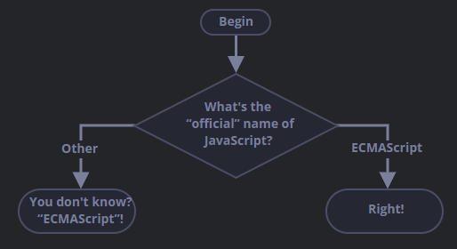
Task
Using the if..else construct, write the code which asks: ‘What is the “official” name of JavaScript?’
If the visitor enters “ECMAScript”, then output “Right!”, otherwise – output: “You don’t know? ECMAScript!”
an I need it as conditional operator

Slide 96
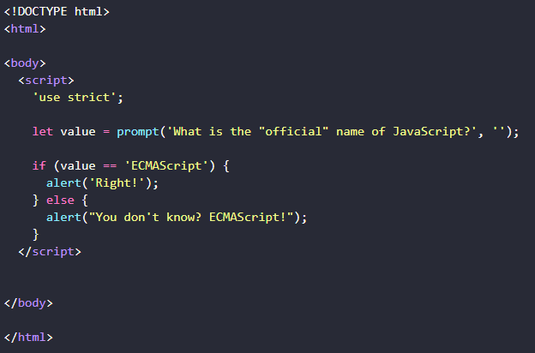
Task solution
Using the if..else construct, write the code which asks: ‘What is the “official” name of JavaScript?’
If the visitor enters “ECMAScript”, then output “Right!”, otherwise – output: “You don’t know? ECMAScript!”

Slide 97
Logical Operators
There are four logical operators in JavaScript: || (OR), && (AND), ! (NOT), ?? (Nullish Coalescing). Here we cover the first three, the ?? operator is in the next article.
Although they are called “logical”, they can be applied to values of any type, not only boolean. Their result can also be of any type.
Let’s see the details.
|| (OR)
The “OR” operator is represented with two vertical line symbols:
result = a || b;

Slide 98
Logical Operators
In classical programming, the logical OR is meant to manipulate boolean values only. If any of its arguments are true, it returns true, otherwise it returns false.
In JavaScript, the operator is a little bit trickier and more powerful. But first, let’s see what happens with boolean values.
There are four possible logical combinations:
alert( true || true ); // true
alert( false || true ); // true
alert( true || false ); // true
alert( false || false ); // false

Slide 99
Logical Operators
Most of the time, OR || is used in an if statement to test if any of the given conditions is true.
For example:
let hour = 9;
if (hour < 10 || hour > 18)
{alert( 'The office is closed.' );}
We can pass more conditions:
let hour = 12;
let isWeekend = true;
if (hour < 10 || hour > 18 || isWeekend)
{alert( 'The office is closed.' ); // it is the weekend}

Slide 100
Logical Operators
&& (AND)
The AND operator is represented with two ampersands &&:
result = a && b;
In classical programming, AND returns true if both operands are truthy and false otherwise:
alert( true && true ); // true
alert( false && true ); // false
alert( true && false ); // false
alert( false && false ); // false

Slide 101
Logical Operators
&& (AND)
An example with if:
let hour = 12;
let minute = 30;
if (hour == 12 && minute == 30)
{alert( 'The time is 12:30' );}

Slide 102
Logical Operators
! (NOT)
The boolean NOT operator is represented with an exclamation sign !.
The syntax is pretty simple:
result = !value;
The operator accepts a single argument and does the following:
  Converts the operand to boolean type: true/false.
  Returns the inverse value.
For instance:
alert( !true ); // false
alert( !0 ); // true
alert( !!null ); // false

Slide 103
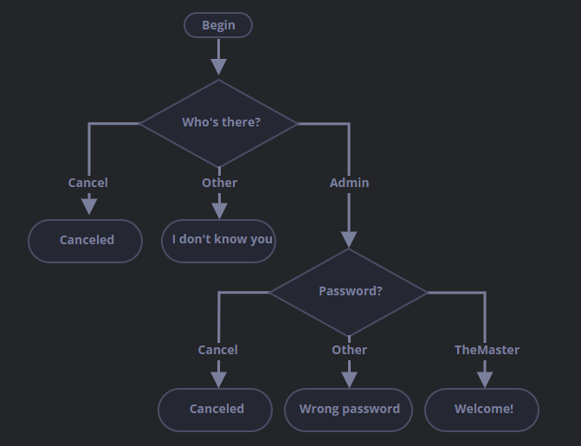
Task
Check the login
Write the code which asks for a login with prompt.
If the visitor enters "Admin", then prompt for a password, if the input is an empty line or Esc – show “Canceled”, if it’s another string – then show “I don’t know you”.
The password is checked as follows:
  If it equals “TheMaster”, then show “Welcome!”,
  Another string – show “Wrong password”,
  For an empty string or cancelled input, show
“Canceled”

Slide 104
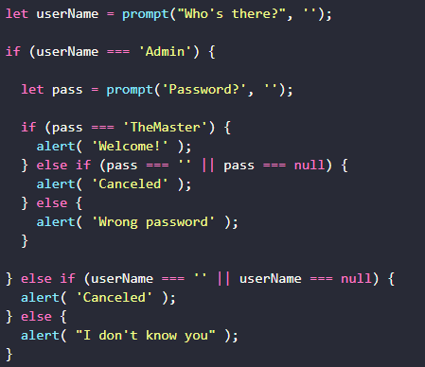
Task solution
Check the login

Slide 105
Loops
Loops are a way to repeat the same code multiple times.
The “while” loop
The while loop has the following syntax:
while (condition) {// code// so-called "loop body"}
While the condition is truthy, the code from the loop body is executed.
For instance, the loop below outputs i while i < 3:
let i = 0;
while (i < 3) { // shows 0, then 1, then 2
alert( i );
i++;}

Slide 106
Loops
The “do…while” loop
The condition check can be moved below the loop body using the do..while syntax:
do {// loop body} while (condition);
The loop will first execute the body, then check the condition, and, while it’s truthy, execute it again and again.
For example:
let i = 0;
do {
alert( i );
i++;} while (i < 3);

Slide 107
Loops
The “for” loop
The for loop is more complex, but it’s also the most commonly used loop.
It looks like this:
for (begin; condition; step) {// ... loop body ...}
Let’s learn the meaning of these parts by example. The loop below runs alert(i) for i from 0 up to (but not including) 3:
for (let i = 0; i < 3; i++)
{ // shows 0, then 1, then 2
alert(i);}

Slide 108
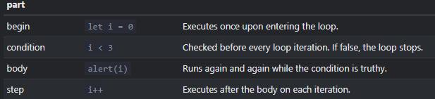
Loops
The “for” loop
for (let i = 0; i < 3; i++)
{ // shows 0, then 1, then 2
alert(i);}
Let’s examine the for statement part-by-part:

Slide 109
Loops
Breaking the loop
Normally, a loop exits when its condition becomes falsy.
But we can force the exit at any time using the special break directive.
For example, the loop below asks the user for a series of numbers, “breaking” when no number is entered:
let sum = 0;
while (true) {
let value = +prompt("Enter a number", '');
if (!value) break;
sum += value;}
alert( 'Sum: ' + sum );

Slide 110
Loops
Continue to the next iteration
The continue directive is a “lighter version” of break. It doesn’t stop the whole loop. Instead, it stops the current iteration and forces the loop to start a new one (if the condition allows).
We can use it if we’re done with the current iteration and would like to move on to the next one.
The loop below uses continue to output only odd values:
for (let i = 0; i < 10; i++) {// if true, skip the remaining part of the body
if (i % 2 == 0) continue;
alert(i); // 1, then 3, 5, 7, 9
}

Slide 111
Task
Repeat until the input is correct
Write a loop which prompts for a number greater than 100. If the visitor enters another number – ask them to input again.
The loop must ask for a number until either the visitor enters a number greater than 100 or cancels the input/enters an empty line.

Slide 112
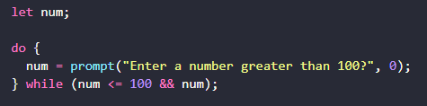
Task Solution
Repeat until the input is correct
Write a loop which prompts for a number greater than 100. If the visitor enters another number – ask them to input again.
The loop must ask for a number until either the visitor enters a number greater than 100 or cancels the input/enters an empty line.

Slide 113
Task
Output prime numbers
An integer number greater than 1 is called a prime if it cannot be divided without a remainder by anything except 1 and itself.
In other words, n > 1 is a prime if it can’t be evenly divided by anything except 1 and n.
For example, 5 is a prime, because it cannot be divided without a remainder by 2, 3 and 4.
Write the code which outputs prime numbers in the interval from 2 to n.
For n = 10 the result will be 2,3,5,7.
P.S. The code should work for any n, not be hard-tuned for any fixed value.

Slide 114
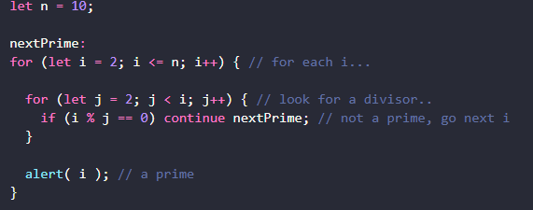
Task Solution
Output prime numbers

Slide 115
Task
Task Description
Create a simple Student Management System using JavaScript that allows the user to enter student information, store grades, and display a full report.
Main Requirements
1 Collect Student Information
Ask the user to enter:
Student Name
Student Age
2 Collect Student Grades
Ask the user to enter grades repeatedly
Stop asking when the user types "stop"
Store all grades inside an array
Validation:
Grade must be a number
Grade must be between 0 and 100
3 Store Data in Object
Create a student object that contains:
Name
Age
Grades Array
4 Calculate Statistics
Calculate:
Average grade
Highest grade
Lowest grade
5 Display Student Report
Display a final report including:
Student Name
Student Age
All Grades
Average Grade
Student Status
Status Rules
Average >= 60 → Passed
Average < 60 → Failed

Slide 116
Bonus Task
Bonus 1 — Input Validation
If user enters:
Text instead of number
Number outside 0 → 100
Show error message
Ask again
Bonus 2 — Minimum Grades Check
Do not allow finishing input unless:
User entered at least 3 grades
Bonus 3 — Grade Classification
Add grade level:
90+ → Excellent
80+ → Very Good
70+ → Good
60+ → Pass
Less than 60 → Fail
Bonus 4 — Continue System
After showing report:
Ask user:
Do you want to enter another student?
Bonus 5 — Show Total Number of Grades
Display:
Total Grades Entered: 5
Last Bonus Store multiple students in an array and display:
All student names
Average for each student

Slide 117
Functions
Quite often we need to perform a similar action in many places of the script.
For example, we need to show a nice-looking message when a visitor logs in, logs out and maybe somewhere else.
Functions are the main “building blocks” of the program. They allow the code to be called many times without repetition.
We’ve already seen examples of built-in functions, like alert(message), prompt(message, default) and confirm(question). But we can create functions of our own as well.

Slide 118
Functions
Function Declaration
To create a function we can use a function declaration.
It looks like this:
function showMessage()
{alert( 'Hello everyone!' );}
showMessage(); // and this is how call function
The function keyword goes first, then goes the name of the function, then a list of parameters between the parentheses (comma-separated, empty in the example above, we’ll see examples later) and finally the code of the function, also named “the function body”, between curly braces.
function name(parameter1, parameter2, ... parameterN) {// body}

Slide 119
Functions
Local variables
A variable declared inside a function is only visible inside that function.
For example:
function showMessage() {
let message = "Hello, I'm JavaScript!"; // local variable
alert( message );}
showMessage(); // Hello, I'm JavaScript!
alert( message ); // <-- Error! The variable is local to the function

Slide 120
Functions
Outer variables
A function can access an outer variable as well, for example:
let userName = 'John';
function showMessage() {
userName = "Bob"; // (1) changed the outer variable
let message = 'Hello, ' + userName;
alert(message);}
alert( userName ); // John before the function call
showMessage();
alert( userName ); // Bob, the value was modified by the function

Slide 121
Functions
Parameters
We can pass arbitrary data to functions using parameters.
In the example below, the function has two parameters: from and text
function showMessage(from, text) { // parameters: from, text
alert(from + ': ' + text);}
showMessage('Ann', 'Hello!'); // Ann: Hello!
showMessage('Ann', "What's up?"); // Ann: What's up?

Slide 122
Functions
Default values
If a function is called, but an argument is not provided, then the corresponding value becomes undefined.
For instance, the aforementioned function showMessage(from, text) can be called with a single argument:
function showMessage(from, text = "no text given")
{alert( from + ": " + text );}
showMessage("Ann"); // Ann: no text given
showMessage("Ann", undefined); // Ann: no text given

Slide 123
Functions
Returning a value
A function can return a value back into the calling code as the result.
The simplest example would be a function that sums two values:
function sum(a, b)
{return a + b;}
let result = sum(1, 2);
alert( result ); // 3

Slide 124
Functions
The directive return can be in any place of the function. When the execution reaches it, the function stops, and the value is returned to the calling code (assigned to result above).
There may be many occurrences of return in a single function. For instance:
function checkAge(age) {
if (age >= 18) { return true;}
else { return confirm('Do you have permission from your parents?’);}
}
let age = prompt('How old are you?', 18);
if ( checkAge(age) ) {alert( 'Access granted' );}
else {alert( 'Access denied' );}

Slide 125
Functions
Naming a function
Functions are actions. So their name is usually a verb. It should be brief, as accurate as possible and describe what the function does, so that someone reading the code gets an indication of what the function does.
It is a widespread practice to start a function with a verbal prefix which vaguely describes the action.
For instance, functions that start with "show" usually show something.
Function starting with…
  "get…" – return a value,
  "calc…" – calculate something,
  "create…" – create something,
  "check…" – check something and return a boolean

Slide 126
Task
Function pow(x,n)
Write a function pow(x,n) that returns x in power n. Or, in other words, multiplies x by itself n times and returns the result.
pow(3, 2) = 3 * 3 = 9
pow(3, 3) = 3 * 3 * 3 = 27
pow(1, 100) = 1 * 1 * ...* 1 = 1

Slide 127
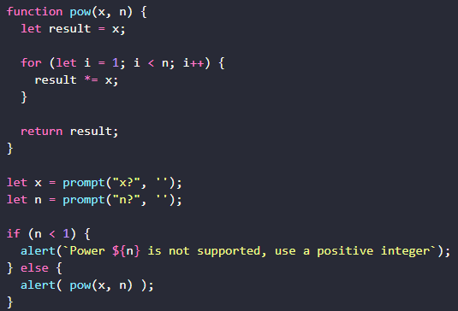
Task Solution
Function pow(x,n)

Slide 128
Functions
Function expressions
In JavaScript, a function is not a “magical language structure”, but a special kind of value.
The syntax that we used before is called a Function Declaration:
function sayHi()
{alert( "Hello" );}
There is another syntax for creating a function that is called a Function Expression.
It allows us to create a new function in the middle of any expression.
For example:
let sayHi = function() {alert( "Hello" );};

Slide 129
Functions
Callback functions
Let’s look at more examples of passing functions as values and using function expressions.
We’ll write a function ask(question, yes, no) with three parameters:
question
Text of the question
yes
Function to run if the answer is “Yes”
no
Function to run if the answer is “No”

Slide 130
Functions
Callback functions
The function should ask the question and, depending on the user’s answer, call yes() or no():
function ask(question, yes, no)
{if (confirm(question)) yes()
else no();}
function showOk()
{alert( "You agreed." );}
function showCancel()
{alert( "You canceled the execution." );}
// usage: functions showOk, showCancel are passed as arguments to ask
ask("Do you agree?", showOk, showCancel);

Slide 131
Functions
Function Expression vs Function Declaration
Let’s formulate the key differences between Function Declarations and Expressions.
First, the syntax: how to differentiate between them in the code.
  Function Declaration: a function, declared as a separate statement, in the main code flow:
// Function Declaration
function sum(a, b) {return a + b;}
  Function Expression: a function, created inside an expression or inside another syntax construct. Here, the function is created on the right side of the “assignment expression” =:
// Function Expression
let sum = function(a, b) {return a + b;};

Slide 132
Functions
A Function Declaration can be called earlier than it is defined.
For example, a global Function Declaration is visible in the whole script, no matter where it is.
That’s due to internal algorithms. When JavaScript prepares to run the script, it first looks for global Function Declarations in it and creates the functions. We can think of it as an “initialization stage”.
And after all Function Declarations are processed, the code is executed. So it has access to these functions.
For example, this works:
sayHi("John"); // Hello, John
function sayHi(name) {alert( `Hello, ${name}` );}
The Function Declaration sayHi is created when JavaScript is preparing to start the script and is visible everywhere in it.

Slide 133
Functions
…If it were a Function Expression, then it wouldn’t work:
sayHi("John"); // error!
let sayHi = function(name)
{ // (*) no magic any more
alert( `Hello, ${name}` );};

Slide 134
Functions
Arrow functions, the basics
There’s another very simple and concise syntax for creating functions, that’s often better than Function Expressions.
It’s called “arrow functions”, because it looks like this:
let func = (arg1, arg2, ..., argN) => expression;
example:
let sum = (a, b) => a + b;
/* This arrow function is a shorter form of:
let sum = function(a, b) {
return a + b;
};
*/alert( sum(1, 2) ); // 3

Slide 135
Functions
Multiline arrow functions
The arrow functions that we’ve seen so far were very simple. They took arguments from the left of =>, evaluated and returned the right-side expression with them.
Sometimes we need a more complex function, with multiple expressions and statements. In that case, we can enclose them in curly braces. The major difference is that curly braces require a return within them to return a value (just like a regular function does).
Like this:
let sum = (a, b) => {
let result = a + b;
return result;
};
alert( sum(1, 2) ); // 3

Slide 136
Thank you

